Slide 1
Quantifying SZZ-Induced Label Noise in Just-In-Time Software Defect Prediction under Verification-Latency-Aware Online Evaluation
Puneet Deshwani
2025MCS013
Under the supervision of Dr. Santosh Singh Rathore
Department of Computer Science and Engineering
Atal Bihari Vajpayee Indian Institute of Information Technology and Management, Gwalior
October 2026

Slide 2
Contents
Overview
Motivation
Related Works
Research Gaps
Research Questions and Objectives
Dataset
Proposed Work
Timeline
References

Slide 3
Overview
Just-in-time software defect prediction (JIT-SDP) predicts, at commit time, whether a code change is likely to introduce a defect, so that review and testing effort can be directed to risky changes [6].
The models are trained on past commits. Each commit is described by change metrics and is labelled as clean or defect-introducing.
These labels are not recorded in the repository. They are inferred by the SZZ algorithm, which traces the lines changed in a bug-fixing commit back to the commits that last modified them [10].
Bug-fixing commits often contain unrelated changes (tangled commits), so SZZ produces wrong labels. Only 17% to 32% of the changed lines in bug-fixing commits contribute to the fix [5].

Slide 4
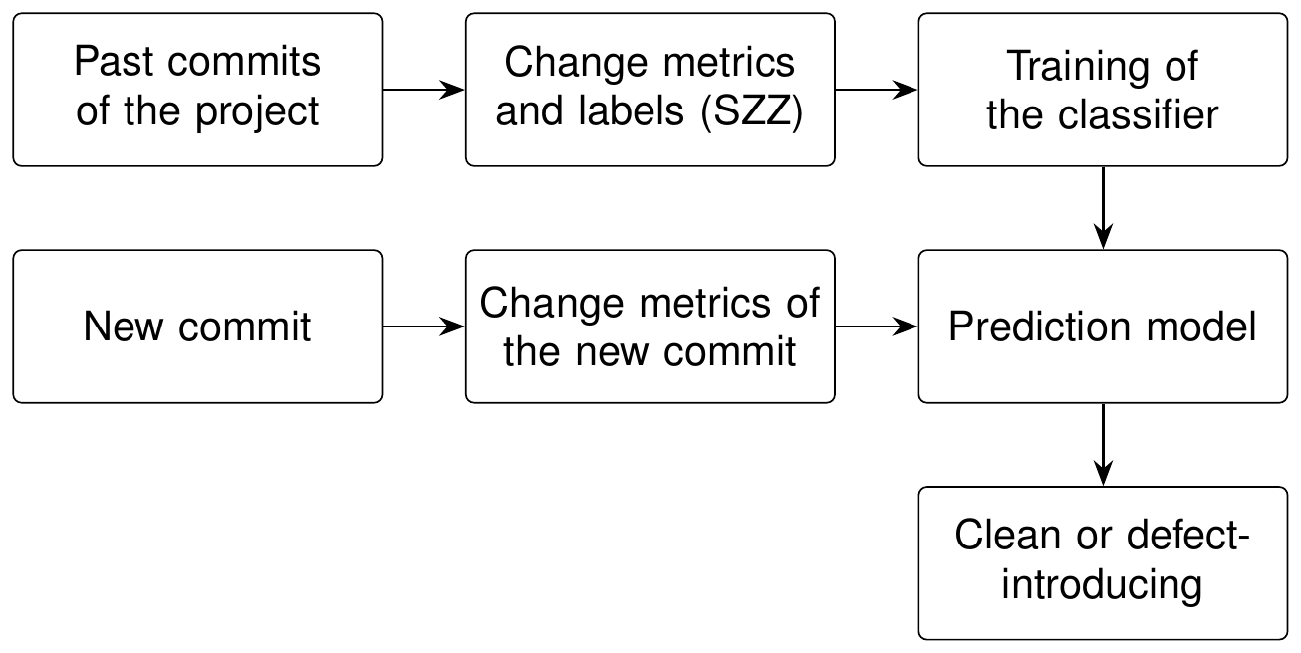
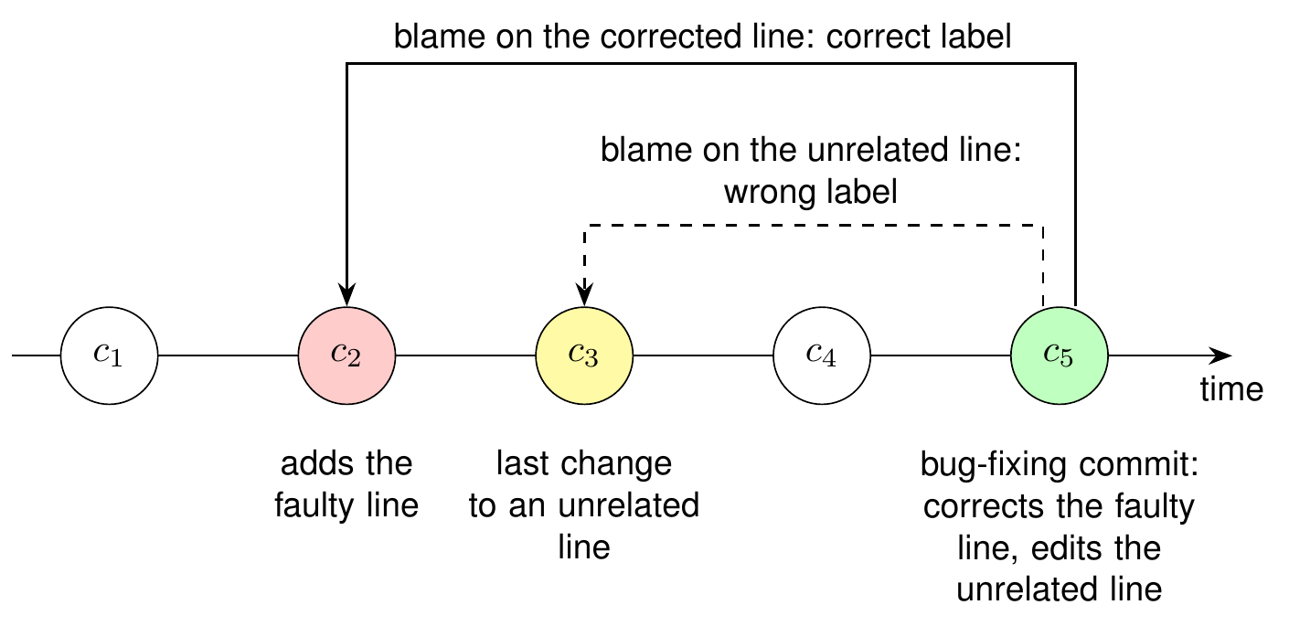
Overview
Figure 1: Workflow of JIT-SDP
Figure 2: Labelling with SZZ and a wrong label caused by an unrelated change

Slide 5
Motivation
JIT-SDP models are trained and tested on the same SZZ labels. A model is then rewarded for reproducing the errors of SZZ, and the effect of label noise on the reported performance is not visible.
Random k-fold cross-validation is still widely used, although it trains the model on commits that are newer than the test commits [3].
In practice the label of a commit arrives late (verification latency): a defect is recognised only when it is fixed, which can take months or years [1].
It is therefore not known how much SZZ label noise costs a model that is evaluated in a realistic setting.

Slide 6
Related Works - 1
Title | Author | Dataset | Key Takeaways
When Do Changes Induce Fixes? (2005) [10] | Jacek Śliwerski | Mozilla and Eclipse | Proposes the SZZ algorithm: lines changed by a bug fix are traced back with annotate (blame) to find the bug-introducing changes
A Framework for Evaluating the Results of the SZZ Approach for Identifying Bug-Introducing Changes (2017) [2] | Daniel A. da Costa | Ten open-source projects | Criteria for evaluating SZZ implementations; proposes MA-SZZ, which ignores meta-changes
Evaluating SZZ Implementations Through a Developer-Informed Oracle (2021) [9] | Giovanni Rosa | 1,930 bug-fixing commits in which the developer names the introducing commit | Compares SZZ variants against the oracle; R-SZZ performs best (precision about 66%); releases PySZZ
A Fine-grained Data Set and Analysis of Tangling in Bug Fixing Commits (2022) [5] | Steffen Herbold | LLTC4J: manually labelled bug-fixing commits of Apache Java projects | Only 17% to 32% of the changed lines contribute to the bug fix; tangling adds noise to defect data
The Impact of Changes Mislabeled by SZZ on Just-in-Time Defect Prediction (2021) [4] | Yuanrui Fan | 126,526 changes from ten Apache projects | Compares four SZZ variants with RA-SZZ as the reference; labels of AG-SZZ reduce performance significantly

Slide 7
Related Works - 2
Title | Author | Dataset | Key Takeaways
A Large-Scale Empirical Study of Just-in-Time Quality Assurance (2013) [6] | Yasutaka Kamei | Six open-source and five commercial projects | 14 change metrics in five groups; 68% accuracy and 64% recall with logistic regression
Are Fix-Inducing Changes a Moving Target? (2018) [7] | Shane McIntosh | Qt and OpenStack (37,524 changes) | Properties of fix-inducing changes change over time; models lose predictive power as they age
Class Imbalance Evolution and Verification Latency in Just-in-Time Software Defect Prediction (2019) [1] | George G. Cabral | Ten GitHub projects | Online JIT-SDP with delayed labels (90-day waiting period); proposes ORB for evolving class imbalance
Deep Just-in-Time Defect Prediction: How Far Are We? (2021) [11] | Zhengran Zeng | Open-source projects with over 310,000 changes | Deep models do not consistently beat simple ones; LApredict (logistic regression on added lines) is best in most cases
The Best of Both Worlds: Integrating Semantic Features with Expert Features for Defect Prediction and Localization (2022) [8] | Chao Ni | JIT-Defects4J: 21 Java projects, 27,319 commits | Dataset built from manually validated bug-fixing lines; proposes JIT-Fine

Slide 8
Research Gaps
Noise of SZZ labels not measured over complete project histories
Models tested against the same labels on which they are trained
Effect of label noise not separated from the effect of the evaluation procedure
Label noise not studied under verification latency
Effect of SZZ noise on online learners not understood, and no remedy for this setting

Slide 9
Research Questions
RQ1: How much do the labels of SZZ variants disagree with one another and with independent reference labels, and what type of error does each variant make?
RQ2: How does the choice of the label source affect the measured performance of JIT-SDP models under different evaluation settings?
RQ3: Through which mechanism does label noise reduce the performance of an online learner, and which type of error is responsible?
RQ4: Can an online learner be made less sensitive to SZZ label noise without access to clean labels?

Slide 10
Objectives
Objective 1: Generate the labels of six SZZ variants for a dataset with independent reference labels, and characterise their false positive and false negative rates.
Objective 2: Examine the agreement between the variants and identify the sources of their errors.
Objective 3: Measure how much the evaluation procedure changes the measured performance of JIT-SDP models.
Objective 4: Measure the loss caused by SZZ labels for an online learner under verification latency.
Objective 5: Identify the type of labelling error responsible for the loss and its mechanism.
Objective 6: Design and evaluate a noise-aware online learner.

Slide 11
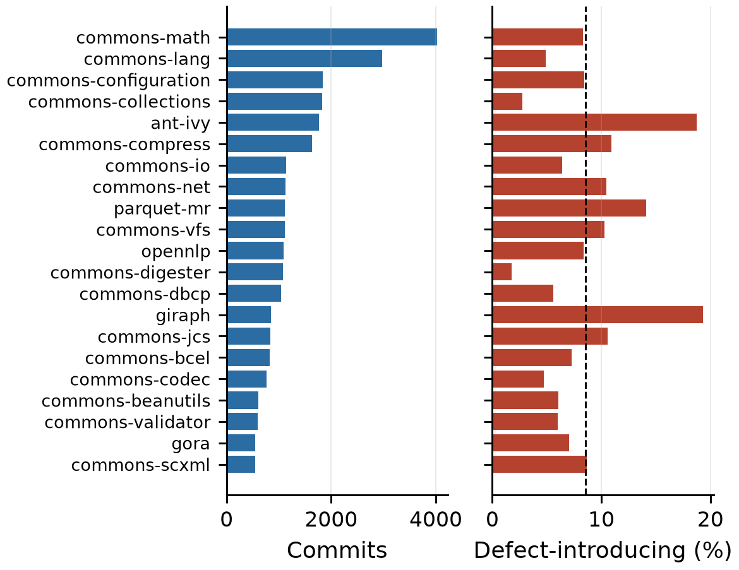
Dataset
JIT-Defects4J [8]: 27,319 commits from 21 Apache Java projects (2001 to 2019)
2,332 commits (8.54%) are defect-introducing; 5,453 commits are bug-fixing
Reference labels: bug-fixing lines validated by at least three of four annotators, then traced back with git blame
Features: the 14 change metrics of Kamei et al. [6]
Selected because its labels do not come from the SZZ variants under study
SZZ labels and label arrival times will be added in MTP II
Figure 3: Commits and defect rate of each project

Slide 12
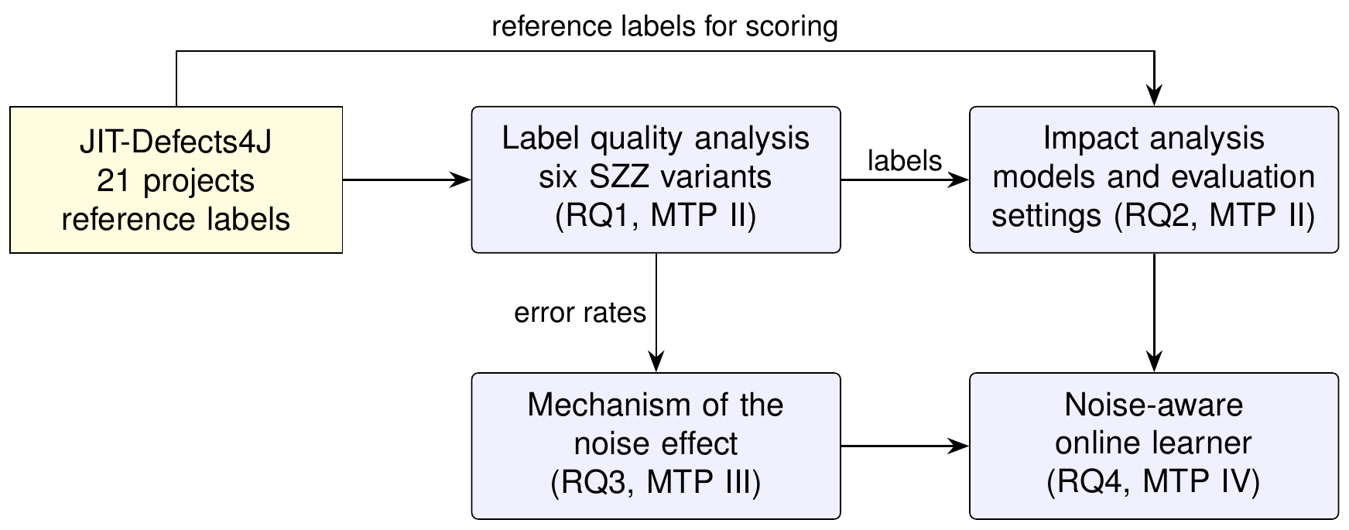
Proposed Work
Figure 4: Planned studies and the research questions they address

Slide 13
Timeline
MTP I
Literature Survey
(Research Gaps,
Dataset)
MTP III
Mechanism of the
Noise Effect
(RQ3)
MTP II
Label Quality and
Impact Analysis
(RQ1, RQ2)
MTP IV
Noise-Aware
Online Learner
(RQ4)
Figure 5: Timeline

Slide 14
References I
[1] | George G. Cabral et al. “Class Imbalance Evolution and Verification Latency in Just-in-Time Software Defect Prediction”. In: Proceedings of the 41st International Conference on Software Engineering (ICSE). 2019, pp. 666-676.
[2] | Daniel Alencar da Costa et al. “A Framework for Evaluating the Results of the SZZ Approach for Identifying Bug-Introducing Changes”. In: IEEE Transactions on Software Engineering 43.7 (2017), pp. 641-657.
[3] | Davide Falessi et al. “On the Need of Preserving Order of Data When Validating Within-Project Defect Classifiers”. In: Empirical Software Engineering 25 (2020), pp. 4805-4830.
[4] | Yuanrui Fan et al. “The Impact of Changes Mislabeled by SZZ on Just-in-Time Defect Prediction”. In: IEEE Transactions on Software Engineering 47.8 (2021), pp. 1559-1586.
[5] | Steffen Herbold et al. “A Fine-grained Data Set and Analysis of Tangling in Bug Fixing Commits”. In: Empirical Software Engineering 27.6 (2022), p. 125.
[6] | Yasutaka Kamei et al. “A Large-Scale Empirical Study of Just-in-Time Quality Assurance”. In: IEEE Transactions on Software Engineering 39.6 (2013), pp. 757-773.
[7] | Shane McIntosh and Yasutaka Kamei. “Are Fix-Inducing Changes a Moving Target? A Longitudinal Case Study of Just-in-Time Defect Prediction”. In: IEEE Transactions on Software Engineering 44.5 (2018), pp. 412-428.
[8] | Chao Ni et al. “The Best of Both Worlds: Integrating Semantic Features with Expert Features for Defect Prediction and Localization”. In: Proceedings of the 30th ACM Joint European Software Engineering Conference and Symposium on the Foundations of Software Engineering (ESEC/FSE). 2022, pp. 672-683.

Slide 15
References II
[9] | Giovanni Rosa et al. “Evaluating SZZ Implementations Through a Developer-Informed Oracle”. In: Proceedings of the 43rd International Conference on Software Engineering (ICSE). 2021.
[10] | Jacek Śliwerski, Thomas Zimmermann, and Andreas Zeller. “When Do Changes Induce Fixes?”. In: Proceedings of the International Workshop on Mining Software Repositories (MSR). 2005, pp. 1-5.
[11] | Zhengran Zeng et al. “Deep Just-in-Time Defect Prediction: How Far Are We?”. In: Proceedings of the 30th ACM SIGSOFT International Symposium on Software Testing and Analysis (ISSTA). 2021.

